Slide 1
GBM Project SP039: CD45+ Cell Isolation and T Regulatory Cell Reclustering
First Meeting 10-10-23
Simone Puccio

Slide 2
Dataset and Clinical Information of Ptz
Single-cell RNA sequencing (scRNA-Seq) study involving 46 patients with glioblastoma (GBM). In this study, 7 patients are classified as having recurrent tumors, while 39 have primary tumors. Four patients were excluded due to a low number of specific cells (CD45+/CD3E+ cells being below 50).
The samples are sourced from 7 different public repositories. Some samples have associated clinical information, including age, sex, IDH1, EGFR, and biopsy localization. The clinical information is stored in a file named "MetadataIntegrationTreg.xlsx."

Slide 3
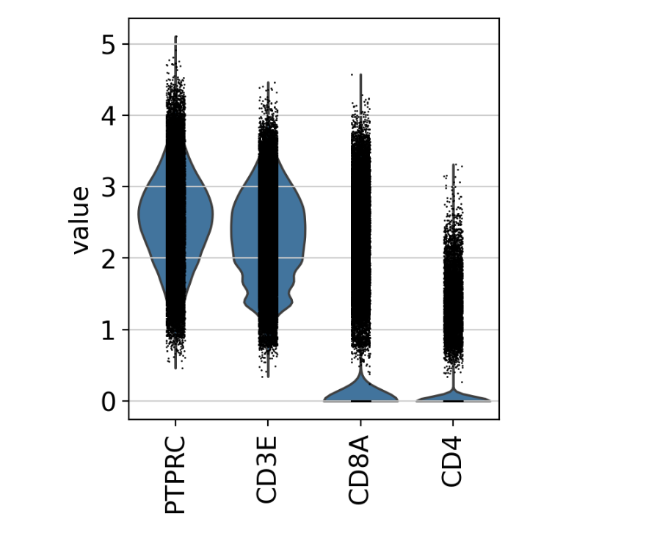
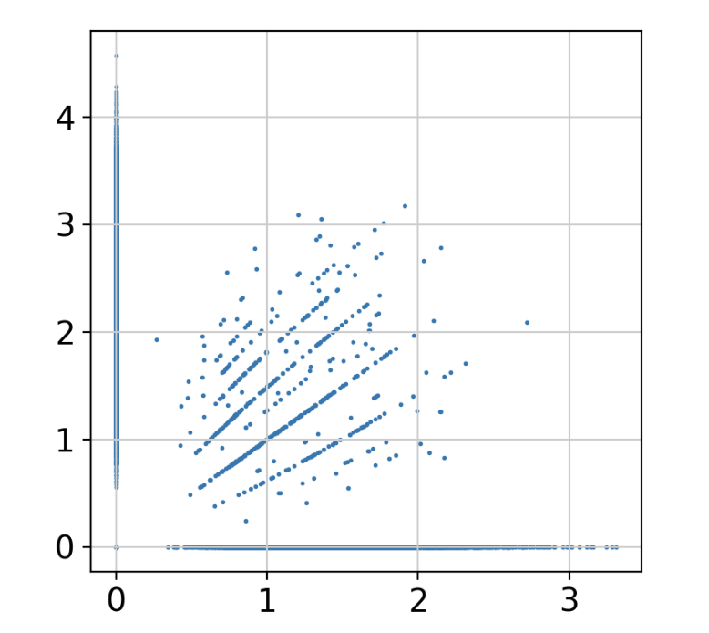
Quality Control and Prefiltering
Single Cohort are pre-analyzed and only Cells CD45+ CD3+ were retained for the down-stream analysis
Mito and Ribo genes are removed, only protein coding genes with functional annotation are retained suitable for the analysis.
Double positive CD4+/CD8+ positive cells were removed.
CD8
CD4

Slide 4
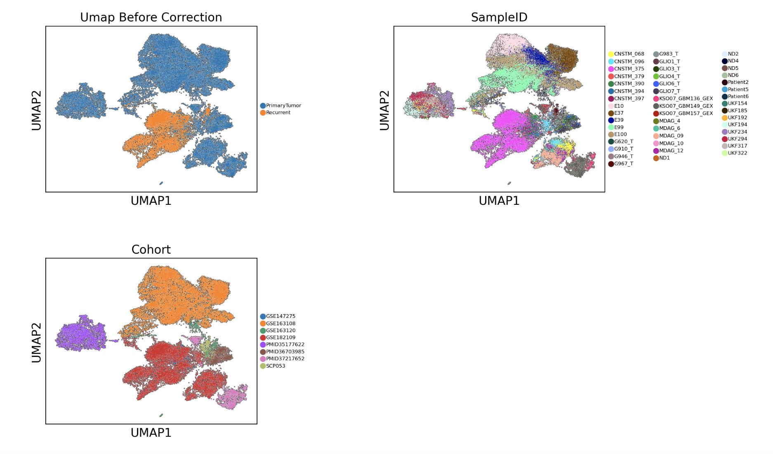
Batch effect evaluation
First, batch effects were assessed and visualized. Subsequently, factors contributing to unwanted biological variation, specifically conditions such as Primary Tumor/Recurrent, Different Sample origins, and Different Cohorts, were identified and retained as covariates.

Slide 5
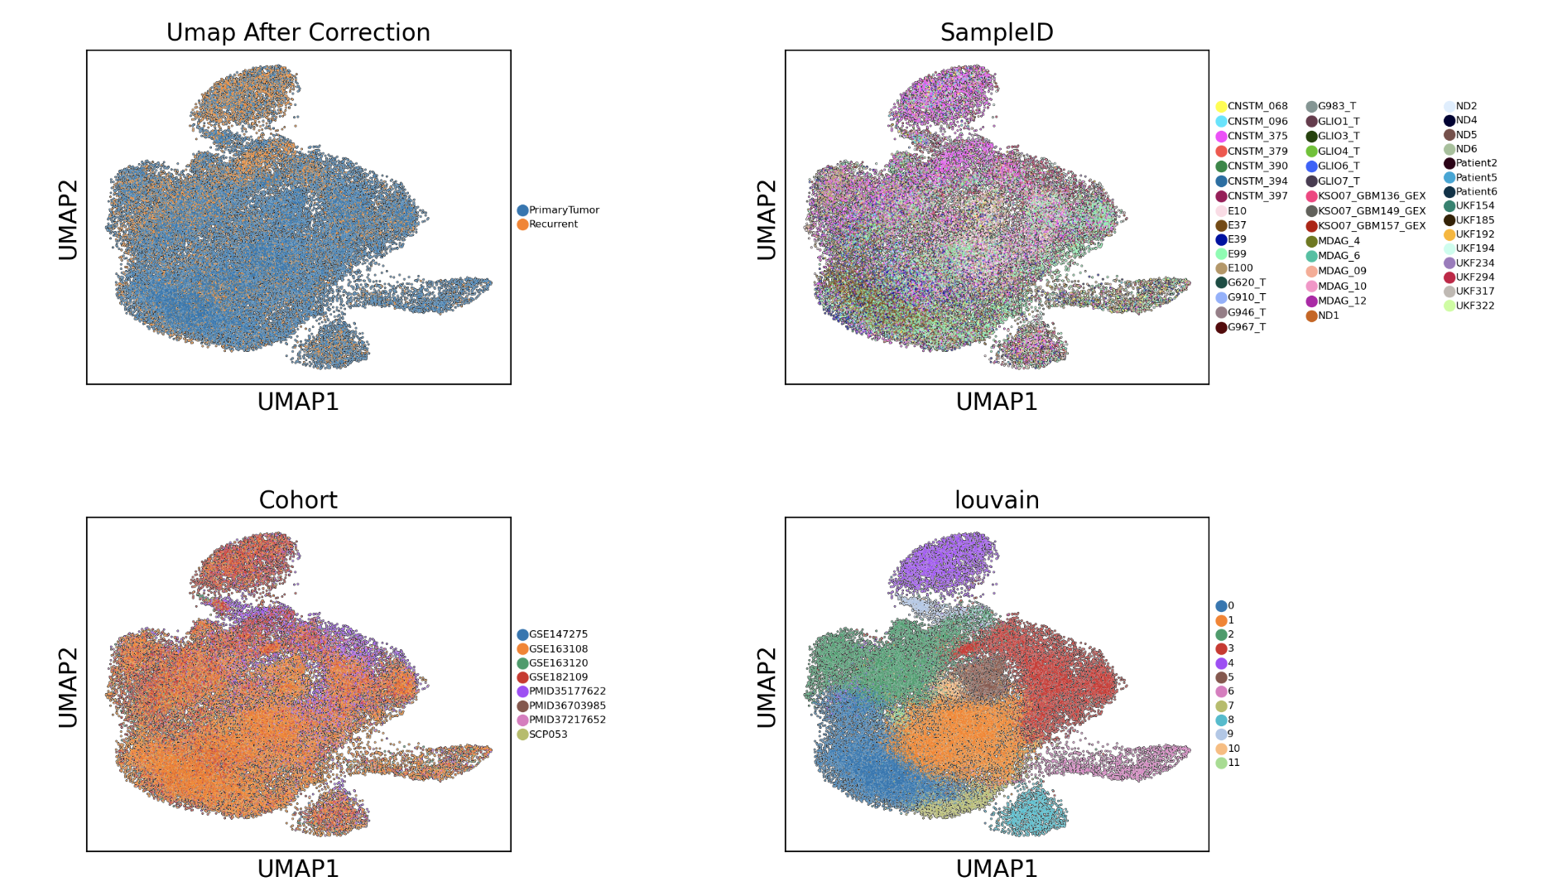
Batch effect removal
Batch effects were mitigated using a specific tool called Harmony. The first 30 principal components (PCAs) were employed along with the Louvain algorithm for clustering.

Slide 6
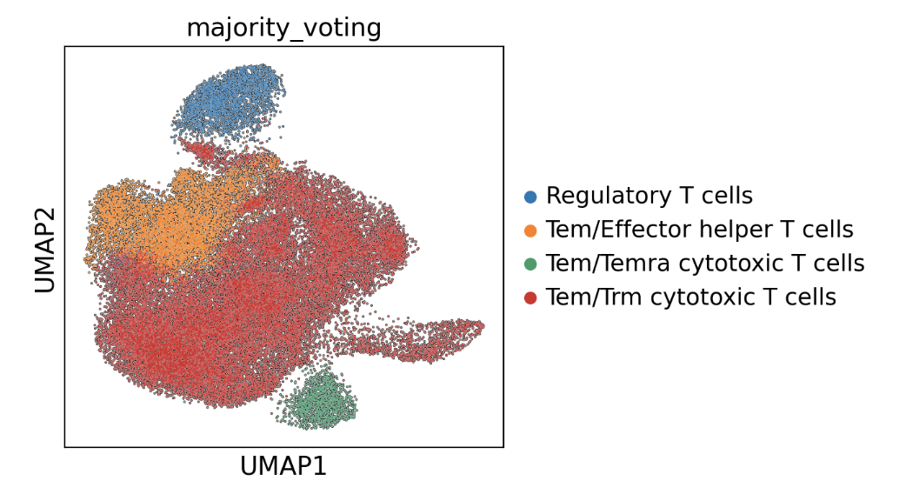
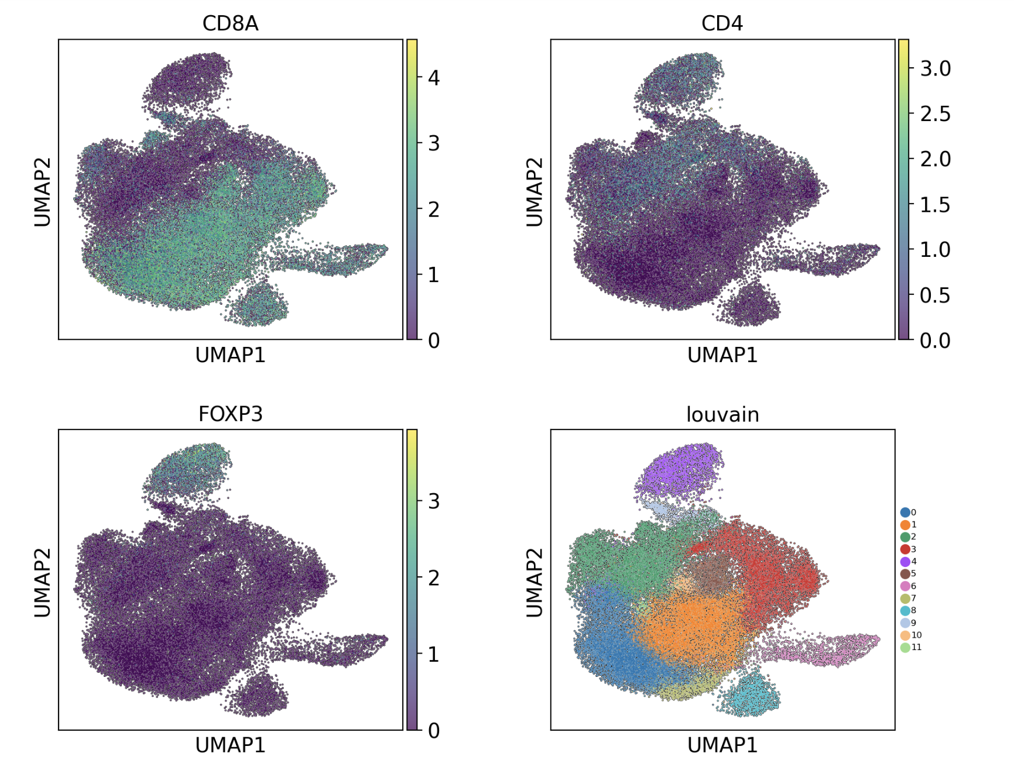
Clustering
We identified 12 clusters, and with the help of CellTypist cell classification, we were able to distinctly recognize CD4 positive T cells, specifically in clusters 2, 4, and 10 based on the Louvain clustering. Notably, cells within cluster 4 were identified as CD4+ T regulatory cells. These specific cells from cluster 4 were subsequently selected for Treg reclustering.

Slide 7
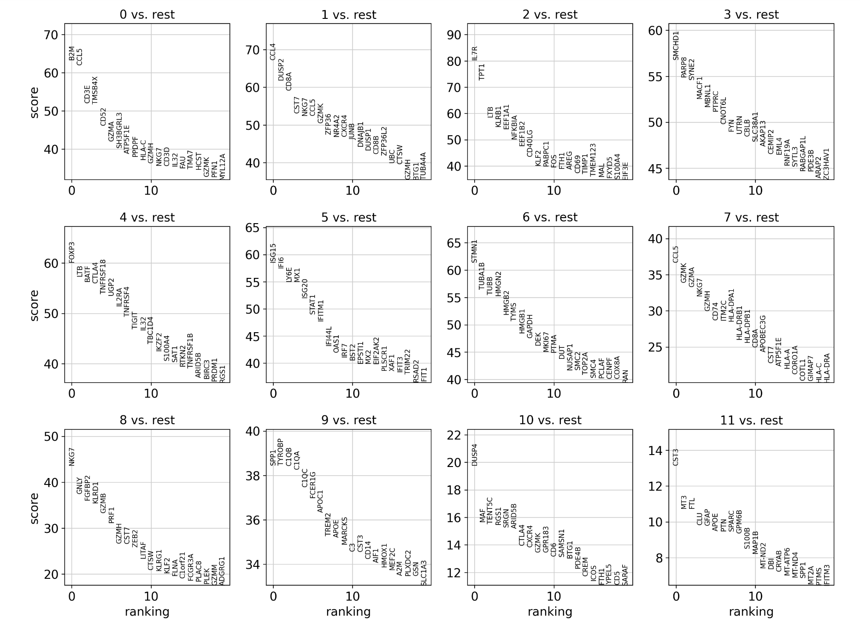
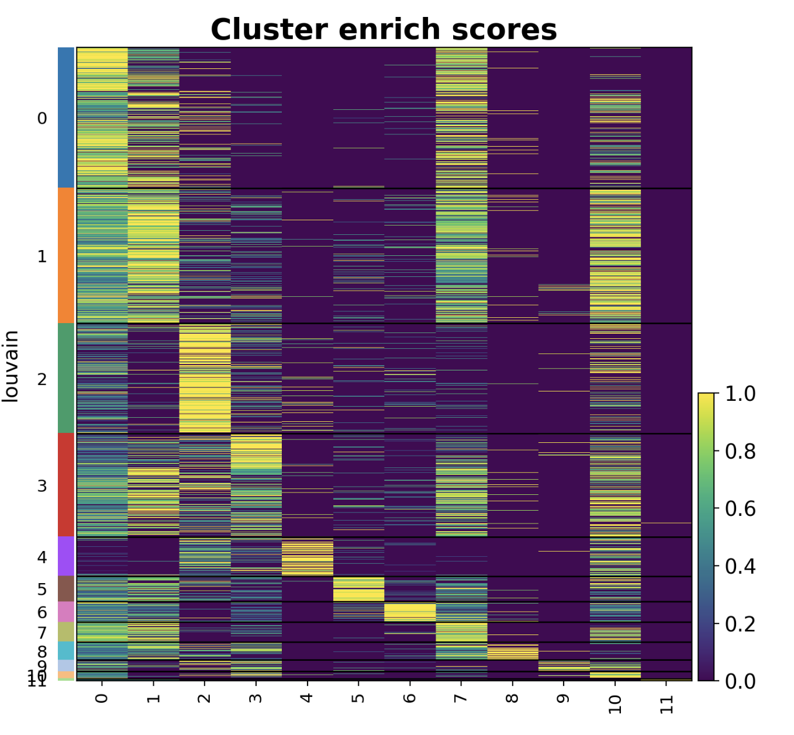
Differentially Genes Expression

Slide 8
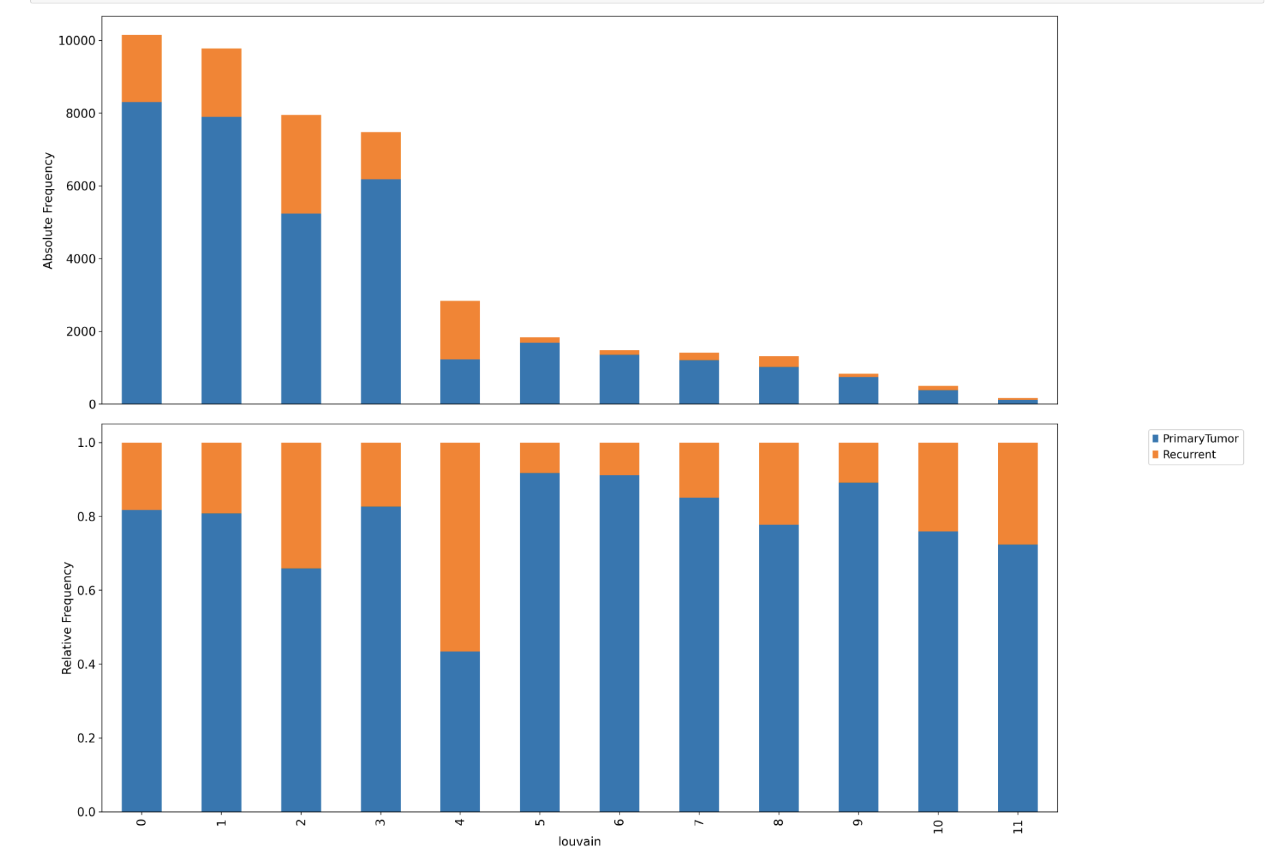
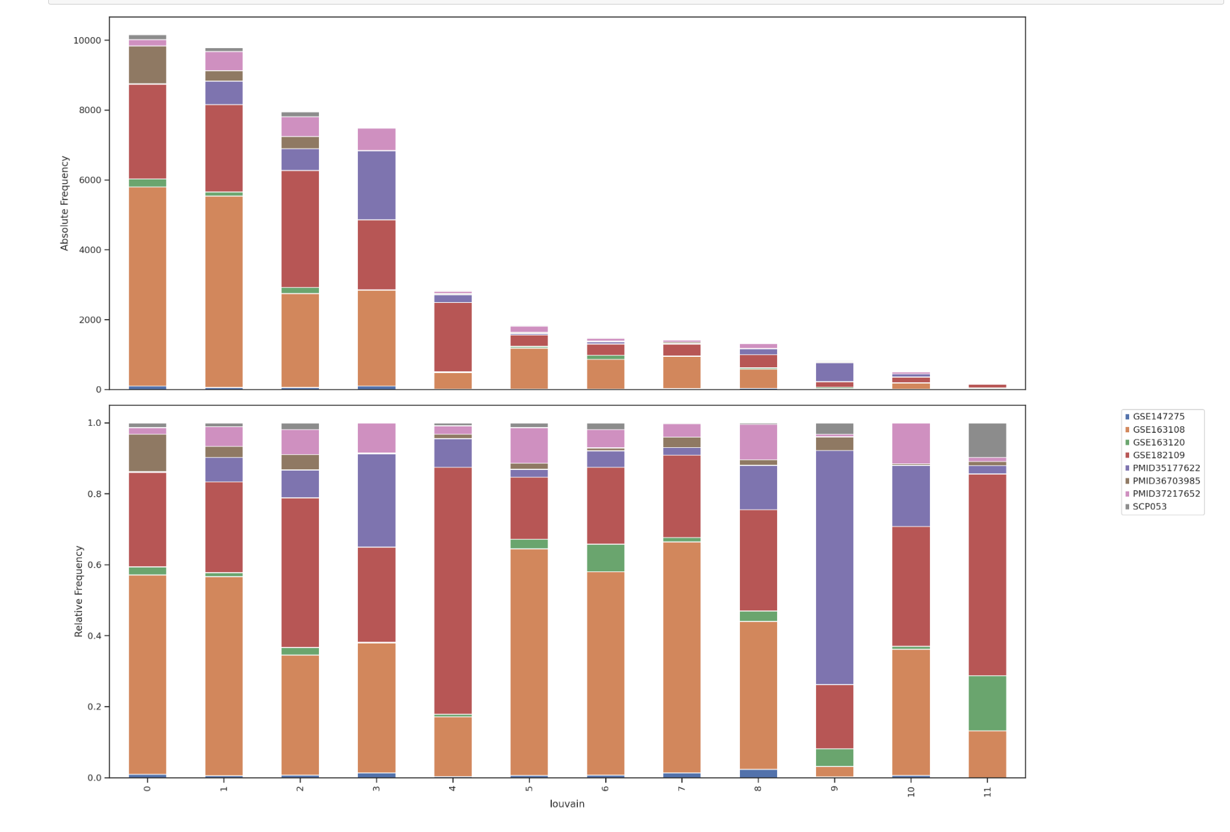
Cluster Frequency - Type and Cohort

Slide 9
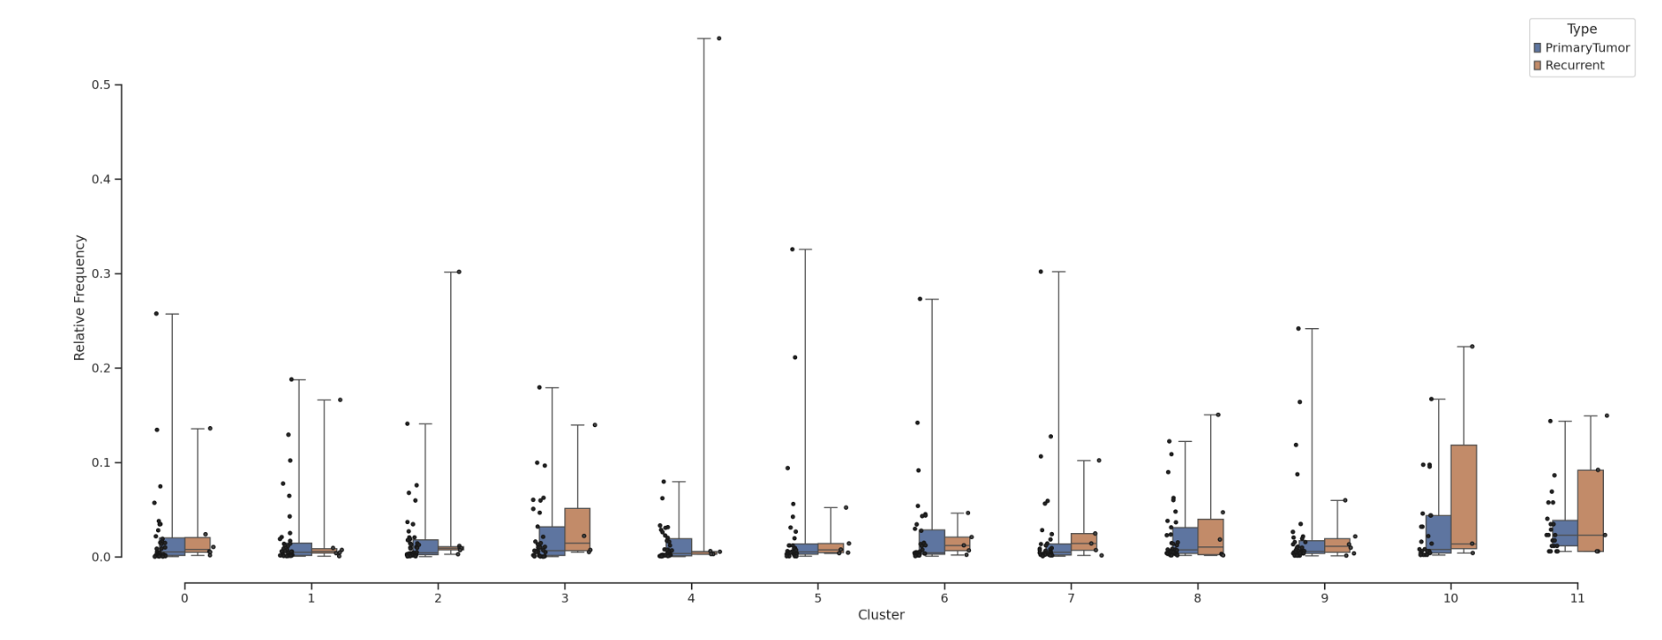
Resolution 2 - Cluster frequency

Slide 10
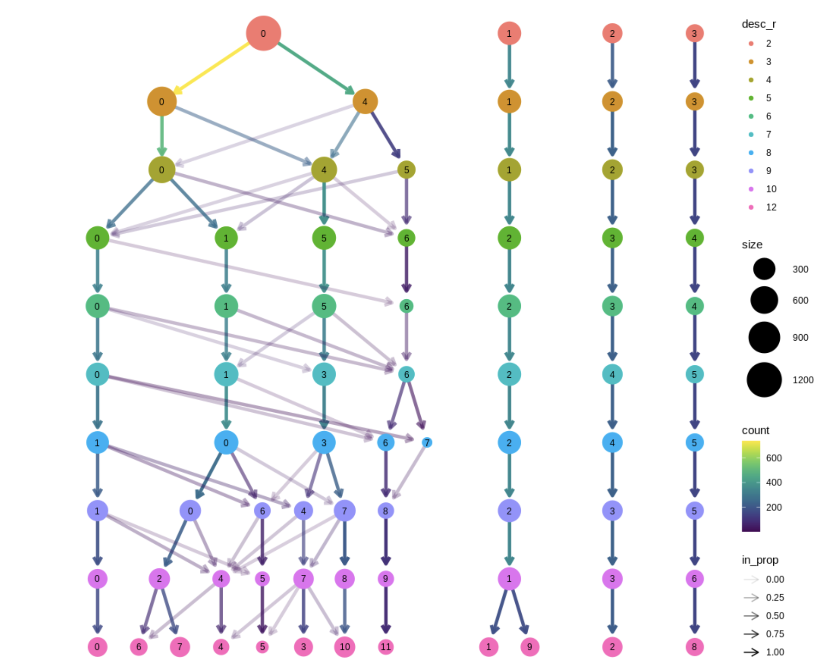
T regulatory cells reclustering

Slide 11
Resolution 2

Slide 12
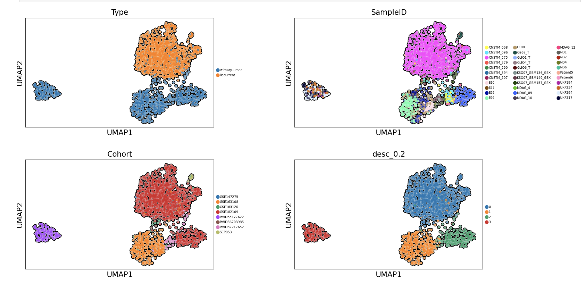
Resolution 2 - Reclustering

Slide 13
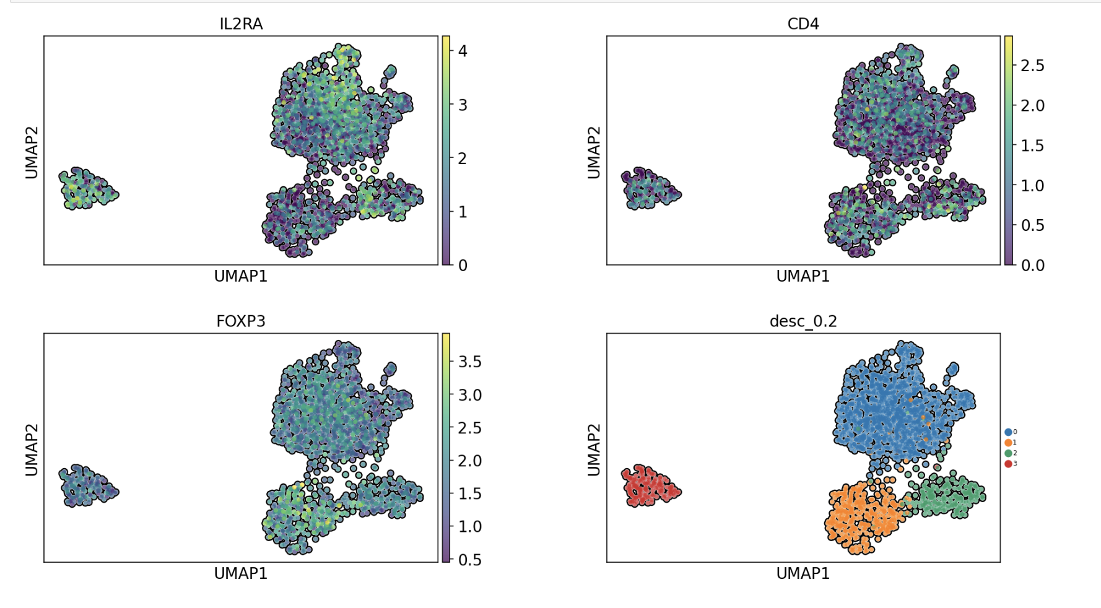
Resolution 2 - Reclustering

Slide 14
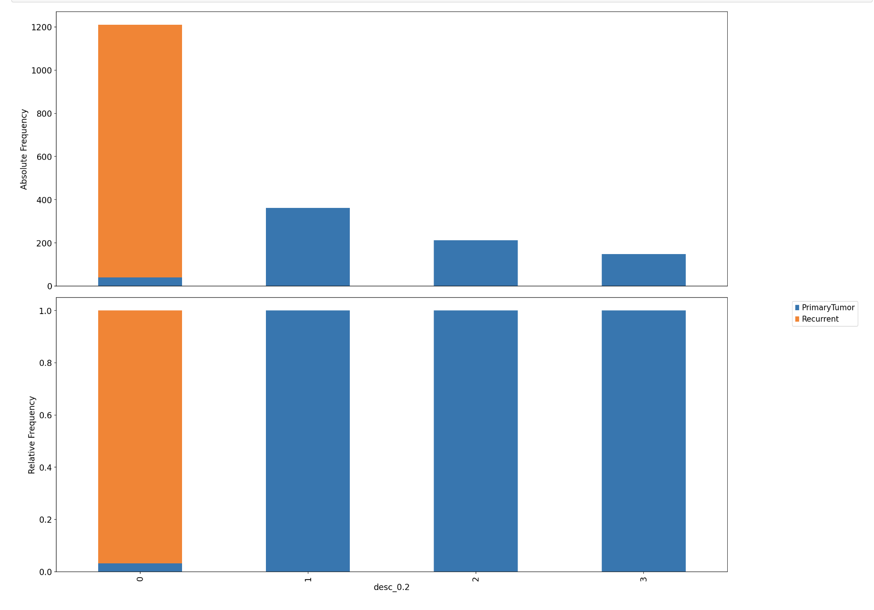
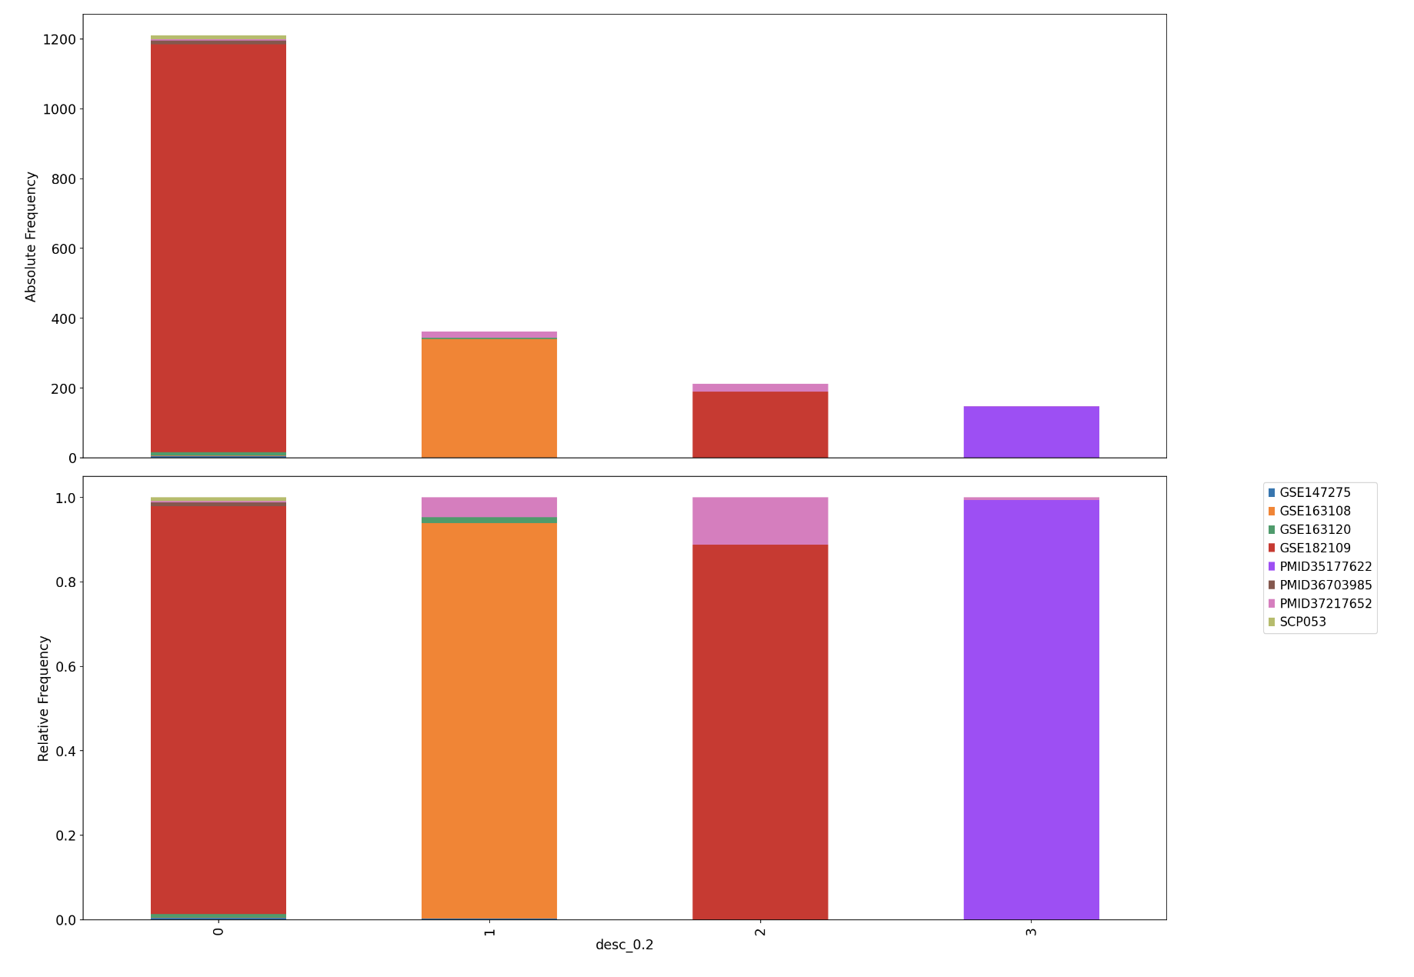
Resolution 2 – Cluster frequency

Slide 15
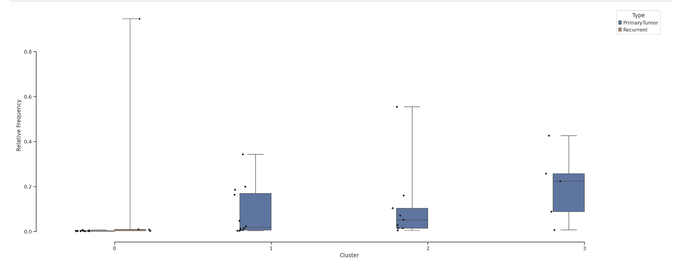
Resolution 2 – Cluster frequency

Slide 16
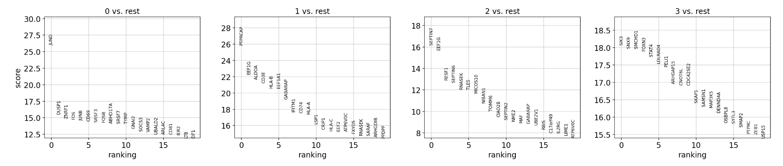
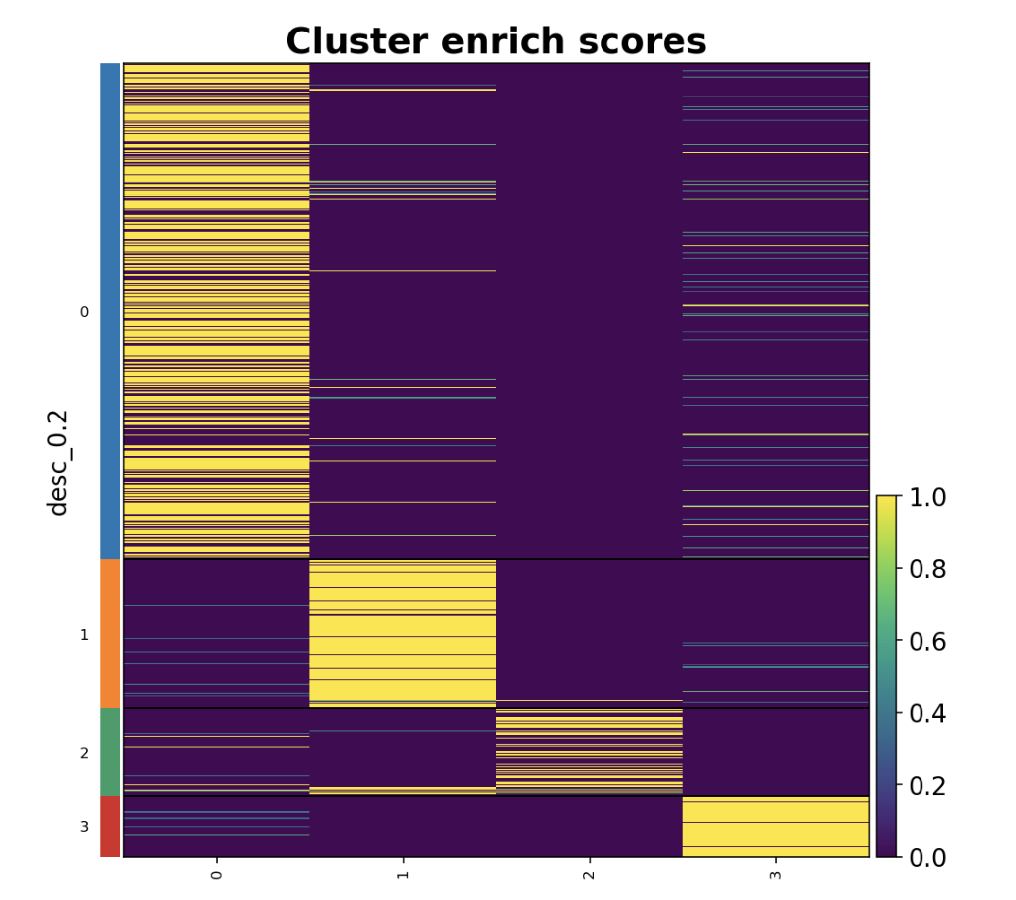
Resolution 2 – DEGS

Slide 17
Resolution 3

Slide 18
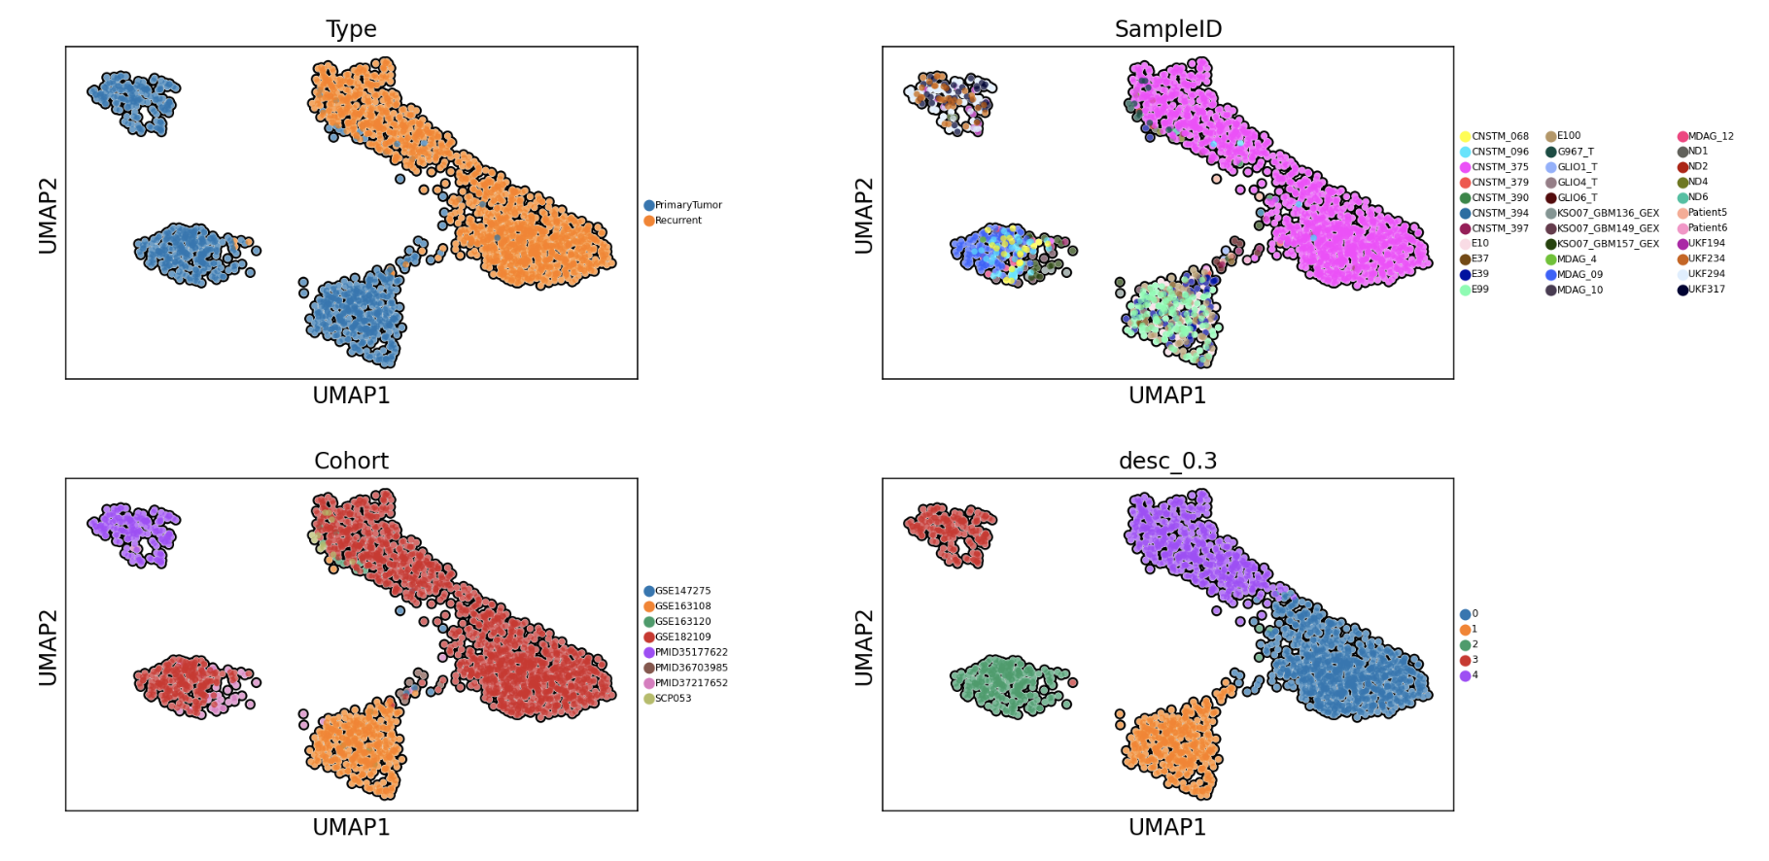
Resolution 3 - Reclustering

Slide 19
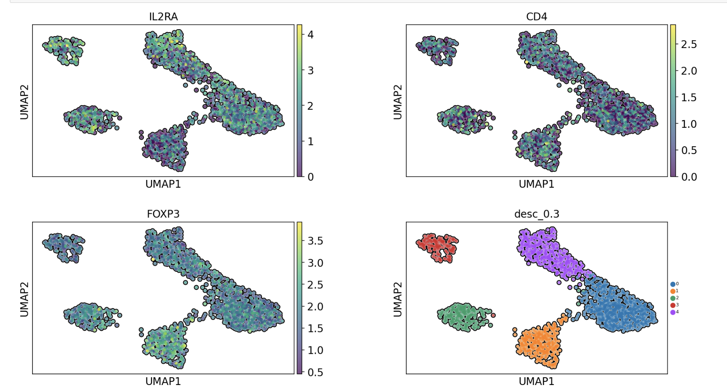
Resolution 3 - Reclustering

Slide 20
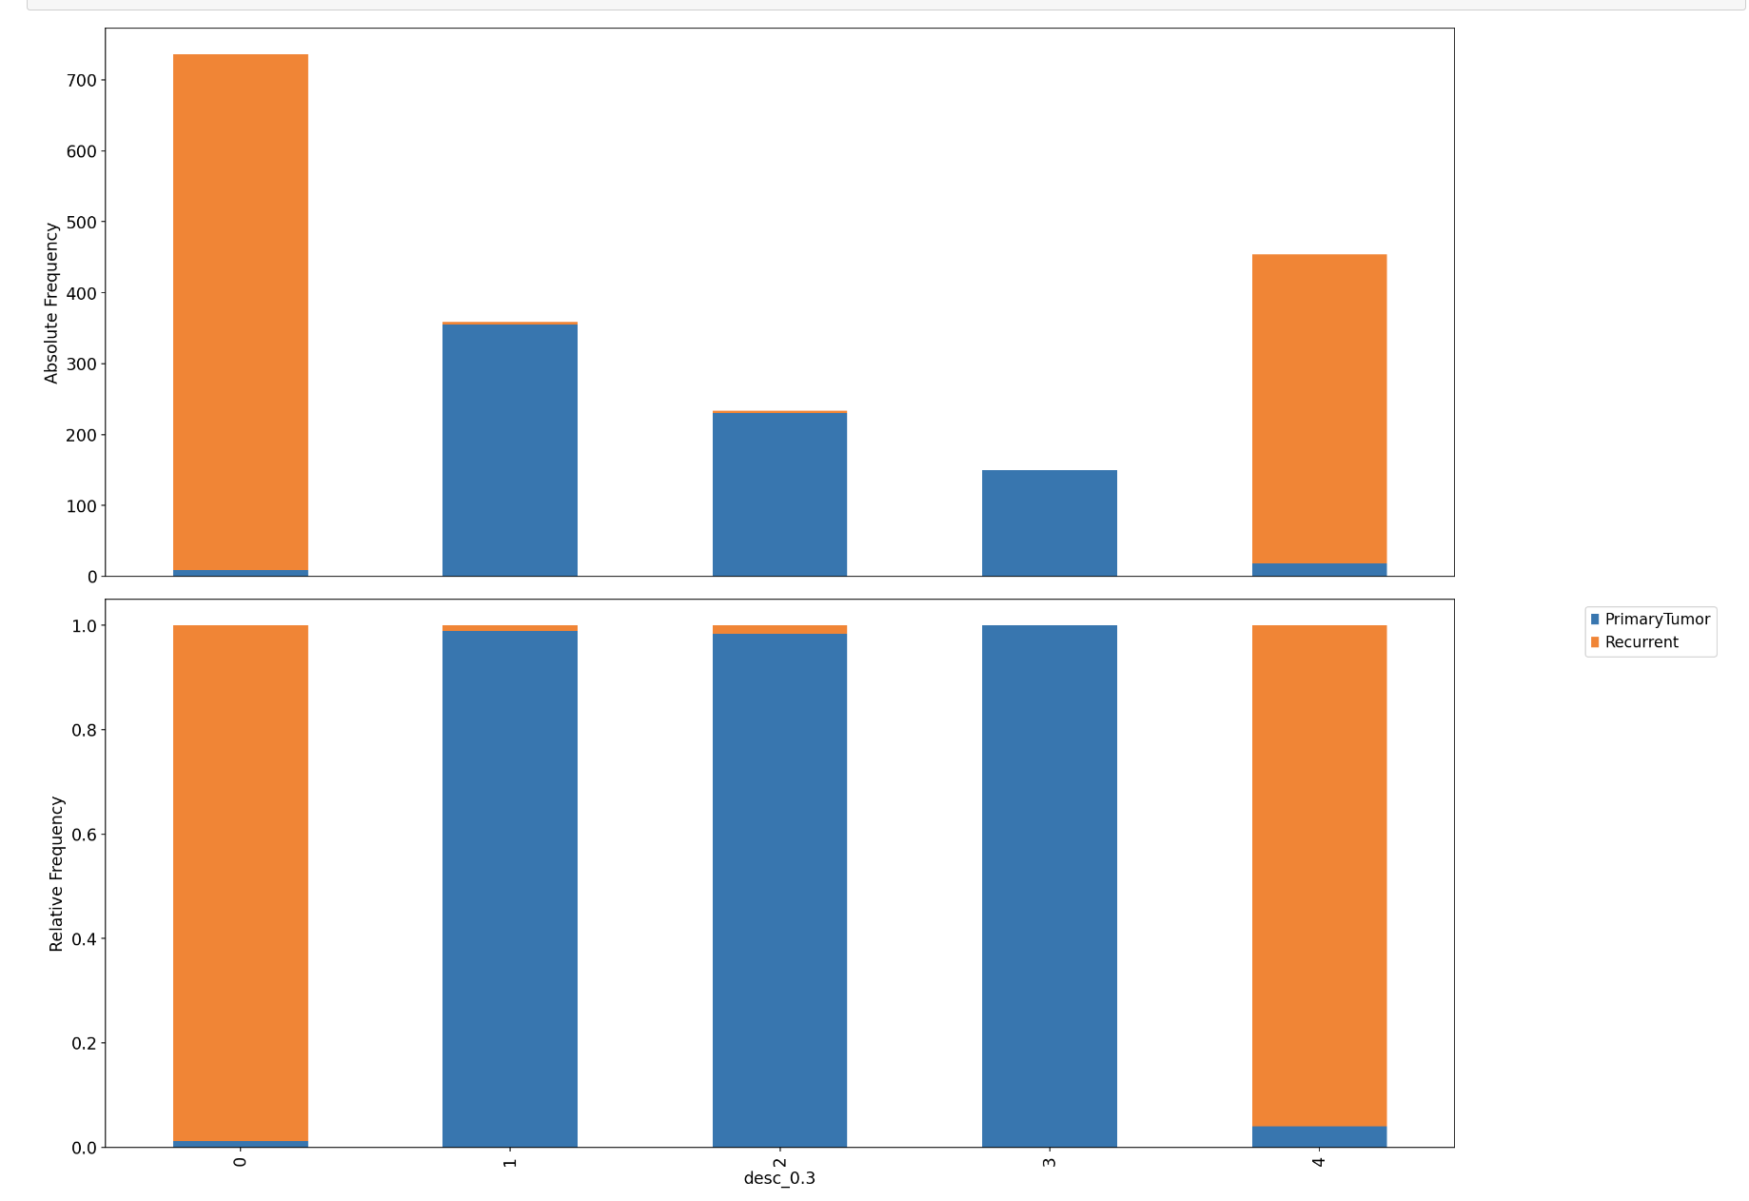
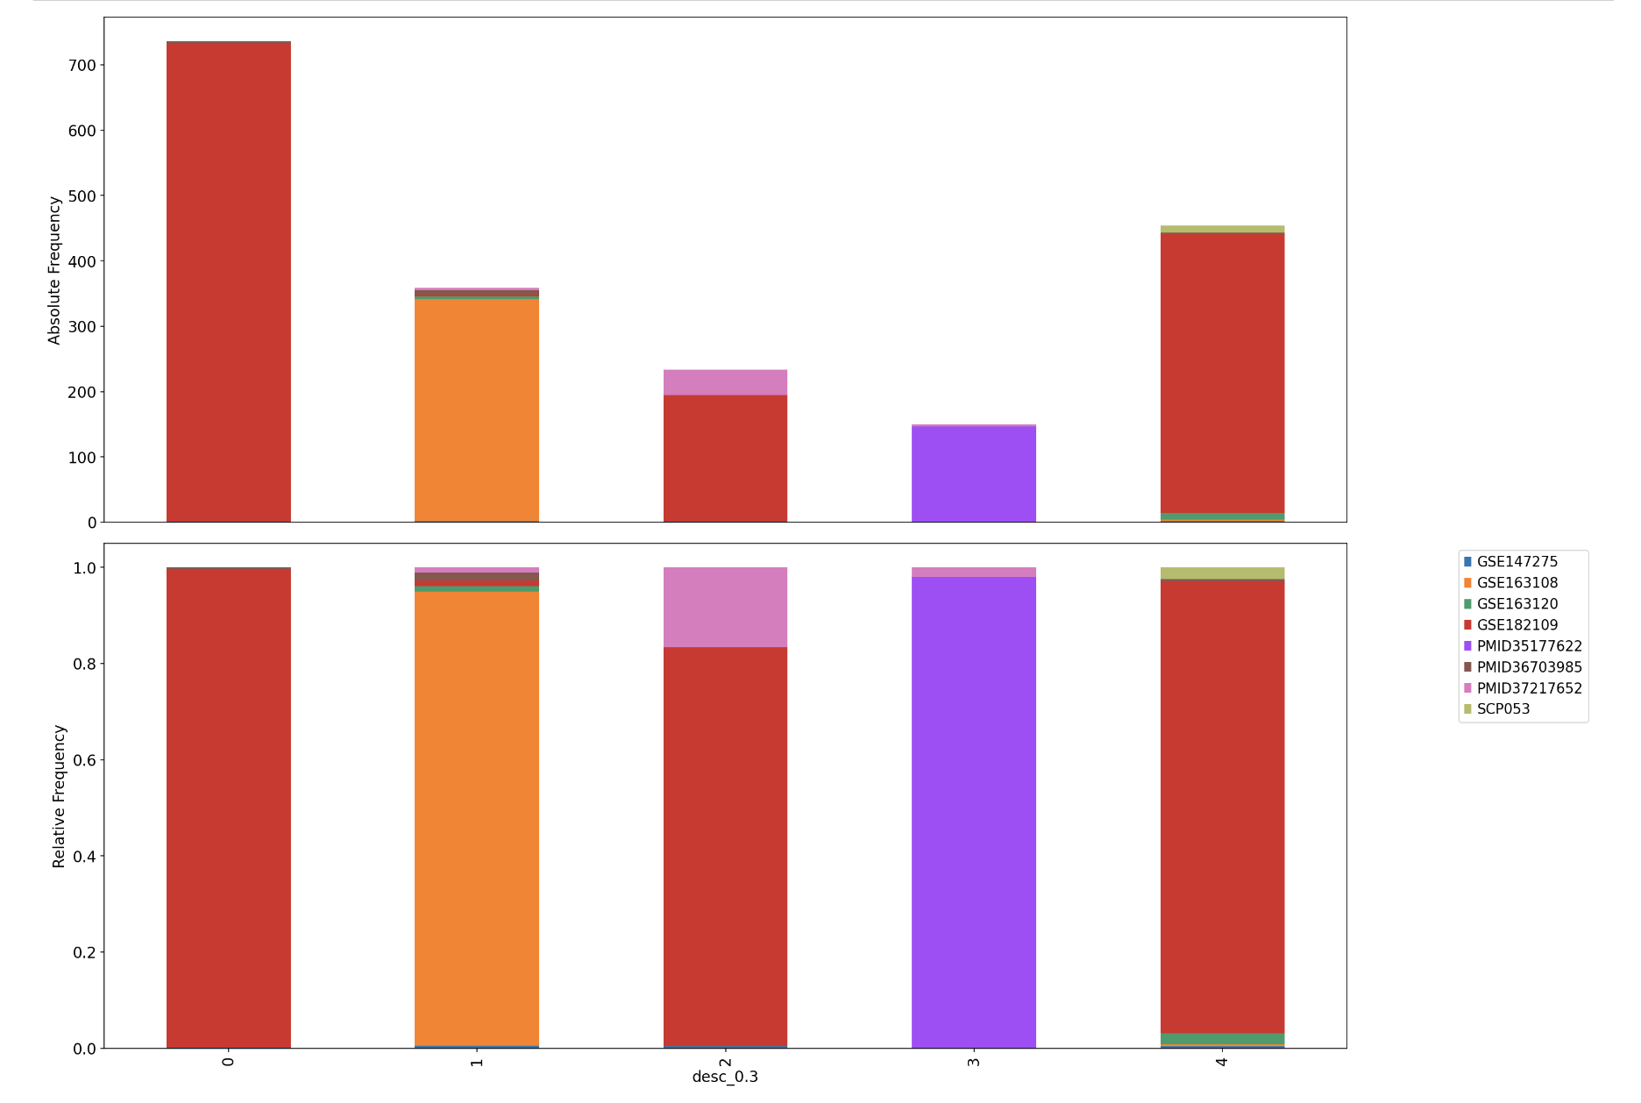
Resolution 3 – Cluster frequency

Slide 21
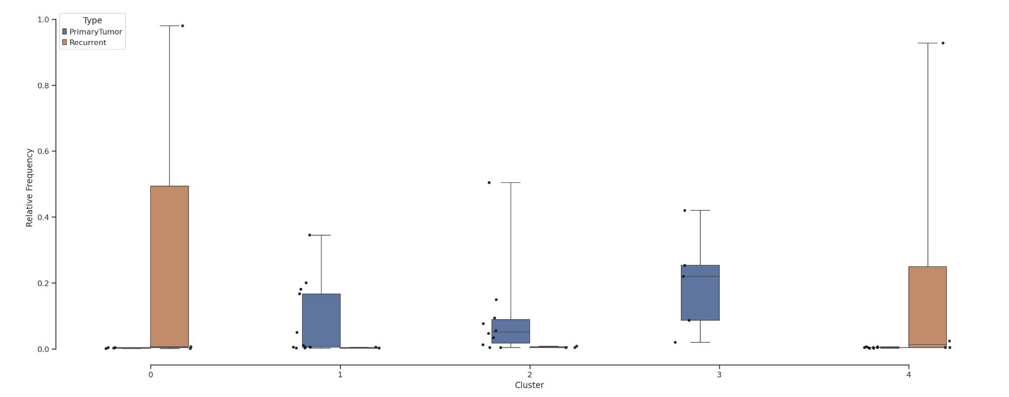
Resolution 3 - Cluster frequency

Slide 22
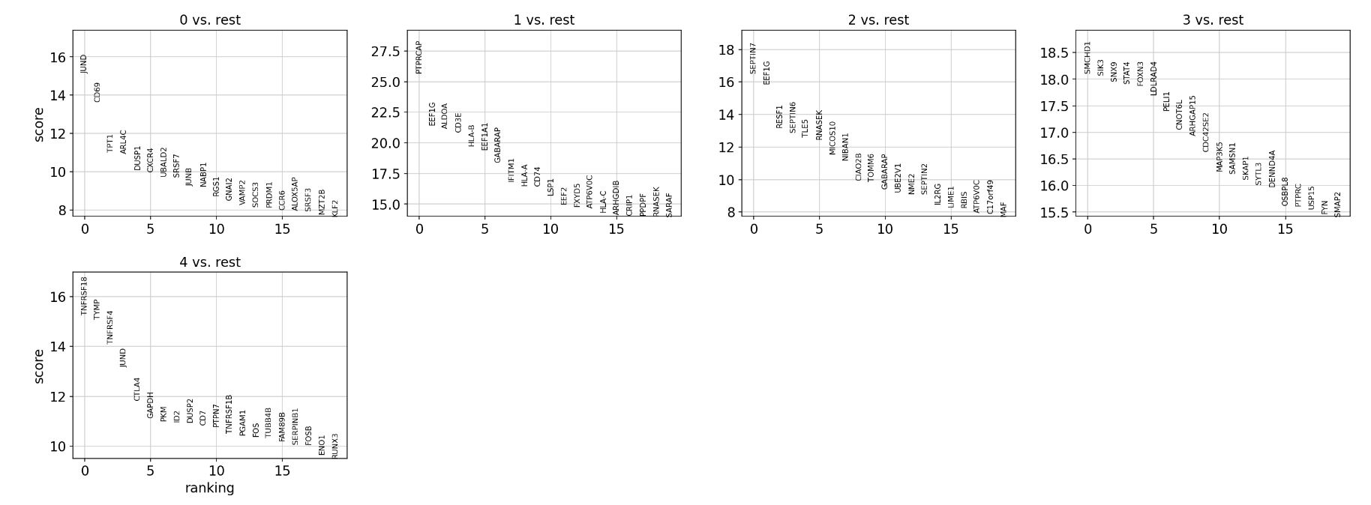
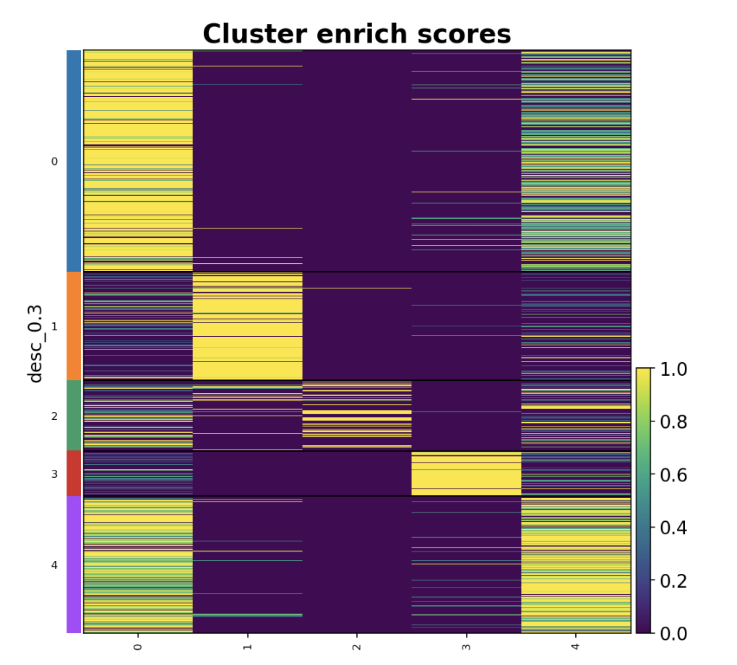
Resolution 3 – DEGS

